Slide 1
Facebook Advertising for Dentists
Do you run a dental practice that provides services like:
Teeth Cleaning, Teeth Whitening, Emergency Dental, Cavities, Crowns, Retainers, Dentures, Implants, Invisalign, Veneers or Cosmetic Dentistry.
Notes:
Do you run a dental practice that provides services like,
Teeth Cleaning, Teeth Whitening, Emergency Dental, Cavities, Crowns, Retainers, Dentures, Implants, Invisalign, Veneers or even Cosmetic Dentistry… (Next Slide)

Slide 2
Facebook Advertising for Dentists
Do you want more patients without having to put in more time in your practice to get new patients?
Notes:
Do you want more patients without having to put in more time in your practice to get new patients?
. (Next Slide)

Slide 3
Facebook Advertising for Dentists
Are you tired of waiting on referrals, relying on yelp or groupon or your website or SEO for new business or having to spend your saturdays at community events?
Notes:
Are you tired of waiting on referrals, relying on yelp or groupon or your website or SEO for new business
or having to spend your saturdays at community events?. (Next Slide)

Slide 4
Facebook Advertising for Dentists
In this video I’m going to show you EXACTLY how to create an “automated system” using Facebook Ads to fill up your practice with people beating down you door to become patients.
Notes:
In this video I’m going to show you EXACTLY how to create an “automated system” using Facebook Ads
to fill up your calendar with people beating down your door to become patients.… (Next Slide)

Slide 5
Facebook Advertising for Dentists
I’ll tell your more about that in a sec but first let me tell you why I’m making this video, who I am, and how I discovered this system for generating patient appointments on demand!
Notes:
I’ll tell your more about that in a sec but first let me tell you why I’m making this video,
who I am
and how I discovered this system for generating patient appointments on demand!… (Next Slide)

Slide 6
Facebook Advertising for Dentists
You see this actually isn’t some sales pitch disguised as some “free training” like other agencies always try to pull.
Notes:
You see this actually isn’t some sales pitch disguised as some “free training” like other agencies always try to pull.... (Next Slide)

Slide 7
Facebook Advertising for Dentists
I’m actually going to be super upfront about my intentions. I’m going to share this system with you and once you see it, you can either choose to…
Notes:
I’m actually going to be super upfront about my intentions.
I’m going to share this system with you and once you see it,
you can either choose to…. (Next Slide)

Slide 8
Facebook Advertising for Dentists
A. Take this information… And do-it-yourself
Notes:
A. Take this information… And do it yourself… (Next Slide)

Slide 9
Facebook Advertising for Dentists
B. Hire me and my team to… Do-it-for-you.
Notes:
Or B. hire me and my team to do it for you…. Its really that simple!... (Next Slide)

Slide 10
Facebook Advertising for Dentists
I know what we offer isn’t for everybody,
In fact we’re pretty selective about who we choose to work with, so either option is cool with me.
Notes:
I know what we offer isn’t for everybody,
In fact we’re pretty selective about who we choose to work with,
so either option is cool with me.. (Next Slide)

Slide 11
Facebook Advertising for Dentists
So who am I ?
Notes:
So who am I ?... (Next Slide)

Slide 12
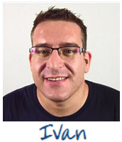
Facebook Advertising for Dentists
Hi, I'm Ivan du Plessis
I’m a Facebook Ads expert and I specialise in delivering new patients to dental practices.
Notes:
Hi, I'm Ivan du Plessis
I’m a Facebook Ads Expert
and I specialise in delivering new patients to dental practices... (Next Slide)

Slide 13
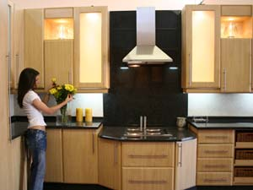


Facebook Advertising for Dentists
I started off working in a family business for over a decade. Where we manufactured and retailed kitchen and bedroom cabinets… I expanded that business from 1 to 10 showrooms and was responsible for all sales and marketing for that company.
Notes:
I started off working in a family business for over a decade. Where we manufactured and retailed kitchen and bedroom cabinets.
I expanded that business to10 showrooms and was responsible for all sales and marketing for the company… (Next Slide)

Slide 14
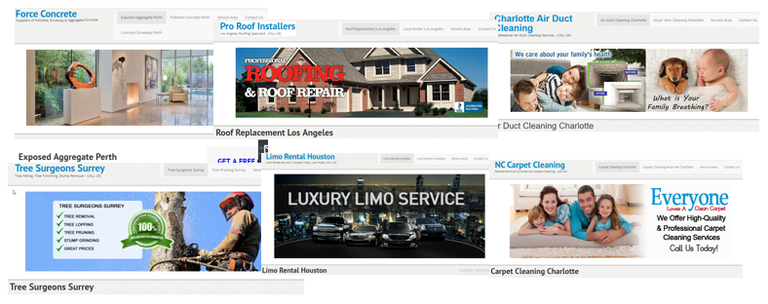
Facebook Advertising for Dentists
From there I moved into the digital marketing space. And for the past several years I have been helping marketing agencies by building out Lead Generation Websites and helping with SEO and have worked with digital agencies in 5 different countries.
Notes:
From there I moved into the digital marketing space.
And for the past several years I have been helping marketing agencies by
building out Lead Generation Websites and helping with SEO
and have worked with digital agencies in 5 different countries… (Next Slide)

Slide 15
Facebook Advertising for Dentists
And while working with these agencies. I was asked if there was a faster and more predictable way of brining in customers.
Notes:
And while working with these agencies.
I was asked if there was a faster and more predictable way of brining in customers … (Next Slide)

Slide 16
Facebook Advertising for Dentists
And for the past 18 months I have been studying Facebook Marketing in depth, and specialising in how to generate patients for Dental Practices.
Notes:
And for the past 12 months I have been studying FB Marketing in depth,
and specialising in how to generate patients for Dental Practices... (Next Slide)

Slide 17
Facebook Advertising for Dentists
So in this short training video, I'm going to show you how to implement a Dentist Facebook Marketing Campaign, and show you how to bring in 30 to 50 new patients at a cost of under $20 a patient.
Notes:
So in this short training video, I'm going to show you how to implement a Dentist Facebook Marketing Campaign,
and show you how to bring in 20 to 50 new patients at a cost of under $5 a patient.... (Next Slide)

Slide 18
Facebook Advertising for Dentists
And this is an exact model, currently being implemented by other dental practices with great success.
Notes:
And this is an exact model, currently being implemented by other dental practices with great success... (Next Slide)

Slide 19
Facebook Advertising for Dentists
$20 in ad spend = 1 new patient
Its only going cost you $1,000 to bring in 50 new patients
Imagine owning a predictable system that will deliver patients at $20 every month on autopilot.
I am going to show you how to do this, right now.
Notes:
So just to be clear… if we are able to spend $5 to bring in 1 new patient.
Its ONLY going to cost you $500 in Ad Spend to bring in 100 new patients…..which is an extremely low amount to get patients into you practice.
Imagine owning a predictable system that will deliver patients on demand,… at $5 every month on autopilot.
I am going to show you how to do this, right now. (Next Slide)

Slide 20
Why Facebook Ads?
Facebook Advertising for Dentists
You want patients but you don't want to overspend on advertising to get those patients. If you make $200,000 in patient sales, but you spent $198,000 to get there, that’s not so good!... In San Diego, the average cost of Billboard advertising for 1 month is $15,000.
Notes:
So first of all… Why Facebook Ads.
Well essentially you want patients… but you don’t want to overspend on advertising to get those patients.
If you make $200,000 in patient sales… but you spend $198,000 to get there,
That is not so good right… and I believe you would agree with me.
To give you an example: In San Diego the average cost of Billboard advertising for 1 month is $15,000… that’s fifteen grand!
Imagine if you spent 15 grand on advertising for billboards.. Here’s what happens (Next Slide)

Slide 21
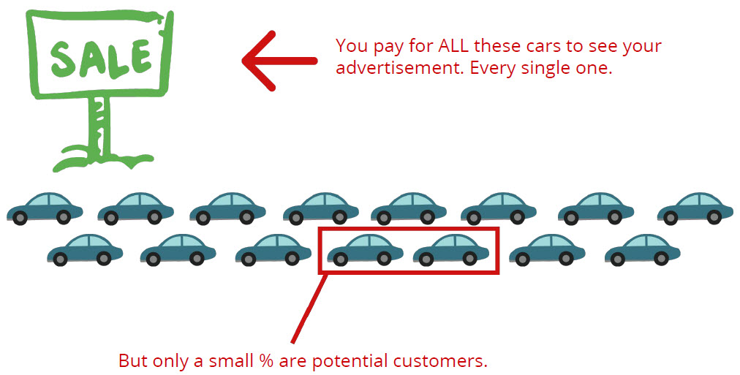
Why Facebook Ads?
Facebook Advertising for Dentists
Notes:
Here is a billboard… And all these cars… They drive by this billboard that you paid for.
Every sing day they ALL drive by….. And you pay for all of these cars to see your billboard, every single month.
But only a very small percentage are potential customers.
So if you got all these cars driving by and you're advertising for a teeth whitening service, or veneers or cosmetic dentistry or whatever.
Perhaps out of this whole group of cars… ONLY 2 people on are on the market for dental care.
So that means you are wasting your advertising dollars on all these people… Which is Not so good. (Next Slide)

Slide 22
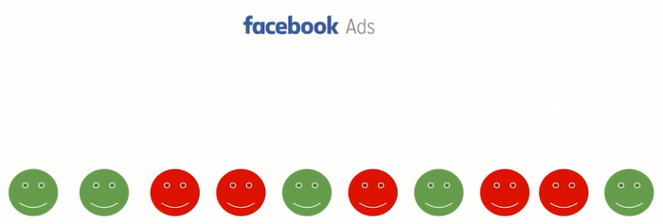
Why Facebook Ads?
Facebook Advertising for Dentists
Facebook Ads are different. You can actually choose who you show your ads to. So if you only target someone likely to buy your product, then only those likely to buy will see your ad! No wasted advertising dollars!
Notes:
With Facebook Ads it’s a little bit different.
You can actually choose who you show your Ads to.
So if you targeted ONLY someone likely to buy your product, then only those likely to Buy will see your Ad.
In other words… We are able to target the correct people… And there is NO wasted advertising dollars (Next Slide)

Slide 23
Why Facebook Ads?
Facebook Advertising for Dentists
Facebook Ads are different. You can actually choose who you show your ads to. So if you only target someone likely to buy your product, then only those likely to buy will see your ad! No wasted advertising dollars!
Notes:
So the green circles are people likely to buy dental services.. And the red circles are people not likely to buy.
With Facebook Ads you can specifically target and show your Ad… ONLY to people likely to buy dental services.
And again this gives you a lot more money for your advertising dollar… And a lot more potential sales.
That’s how we are able to spend so little with FB Ads… And get so much. (Next Slide)

Slide 24
Let me explain the “Value Ladder”
Facebook Advertising for Dentists
Notes:
Now let me explain the “Value Ladder” to you (Next Slide)

Slide 25
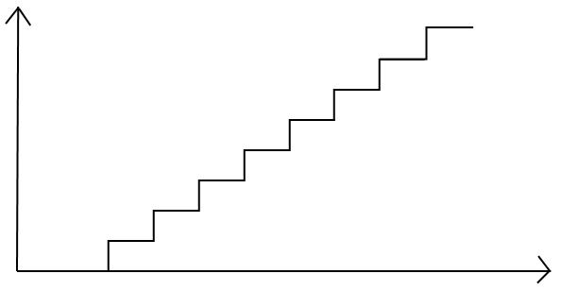
How The Value Ladder Works
Facebook Advertising for Dentists
Cosmetic Surgery
VALUE
Invisalign
Veneers
Implants
Retainers/Braces
Cavities/Crowns
Teeth Whitening Package
Free/Low Cost Attractive Special Offer - (Fill practice with patients!)
Notes:
So each new customer has a LIFELONG VALUE… and This Is Where The Money Is At.
You make use of an irresistible offer to bring patients into your practice.
And you make ALL your money by upselling customers on your different monthly packages you provide.
PLUS by taking care of patients that need procedures now.
The money is Made… NOT on the initial offer.
But on ALL the Additional Services you will provide… Now that you have New Customers to work with.
But it all starts with an attractive offer to bring new patients into your practice… (Next Slide)

Slide 26

How The Value Ladder Works
Facebook Advertising for Dentists
Cosmetic Surgery
VALUE
Invisalign
Veneers
Implants
Retainers/Braces
Cavities/Crowns
Teeth Whitening Package
Free/Low Cost Attractive Special Offer - (Fill practice with patients!)
Notes:
So each new customer has a LIFELONG VALUE… and This Is Where The Money Is At.
You make use of an irresistible offer to bring patients into your practice.
And you make ALL your money by upselling customers on your different monthly packages you provide.
PLUS by taking care of patients that need procedures now.
The money is Made… NOT on the initial offer.
But on ALL the Additional Services you will provide… Now that you have New Customers to work with.
But it all starts with an attractive offer to bring new patients into your practice… (Next Slide)

Slide 27

How The Value Ladder Works
Facebook Advertising for Dentists
Cosmetic Surgery
VALUE
Invisalign
Veneers
Implants
Retainers/Braces
Cavities/Crowns
Teeth Whitening Package
Free/Low Cost Attractive Special Offer - (Fill practice with patients!)
Notes:
So each new customer has a LIFELONG VALUE… and This Is Where The Money Is At.
You make use of an irresistible offer to bring patients into your practice.
And you make ALL your money by upselling customers on your different monthly packages you provide.
PLUS by taking care of patients that need procedures now.
The money is Made… NOT on the initial offer.
But on ALL the Additional Services you will provide… Now that you have New Customers to work with.
But it all starts with an attractive offer to bring new patients into your practice… (Next Slide)

Slide 28
How The Value Ladder Works
Facebook Advertising for Dentists
Cosmetic Surgery
VALUE
Invisalign
Veneers
Implants
Retainers/Braces
Cavities/Crowns
Teeth Whitening Package
Free/Low Cost Attractive Special Offer - (Fill practice with patients!)
Notes:
So each new customer has a LIFELONG VALUE… and This Is Where The Money Is At.
You make use of an irresistible offer to bring patients into your practice.
And you make ALL your money by upselling customers on your different monthly packages you provide.
PLUS by taking care of patients that need procedures now.
The money is Made… NOT on the initial offer.
But on ALL the Additional Services you will provide… Now that you have New Customers to work with.
But it all starts with an attractive offer to bring new patients into your practice… (Next Slide)

Slide 29
How The Value Ladder Works
Facebook Advertising for Dentists
Cosmetic Surgery
VALUE
Invisalign
Veneers
Implants
Retainers/Braces
Cavities/Crowns
Teeth Whitening Package
Free/Low Cost Attractive Special Offer - (Fill practice with patients!)
Notes:
So each new customer has a LIFELONG VALUE… and This Is Where The Money Is At.
You make use of an irresistible offer to bring patients into your practice.
And you make ALL your money by upselling customers on your different monthly packages you provide.
PLUS by taking care of patients that need procedures now.
The money is Made… NOT on the initial offer.
But on ALL the Additional Services you will provide… Now that you have New Customers to work with.
But it all starts with an attractive offer to bring new patients into your practice… (Next Slide)

Slide 30
How The Value Ladder Works
Facebook Advertising for Dentists
Cosmetic Surgery
VALUE
Invisalign
Veneers
Implants
Retainers/Braces
Cavities/Crowns
Teeth Whitening Package
Free/Low Cost Attractive Special Offer - (Fill practice with patients!)
Notes:
So each new customer has a LIFELONG VALUE… and This Is Where The Money Is At.
You make use of an irresistible offer to bring patients into your practice.
And you make ALL your money by upselling customers on your different monthly packages you provide.
PLUS by taking care of patients that need procedures now.
The money is Made… NOT on the initial offer.
But on ALL the Additional Services you will provide… Now that you have New Customers to work with.
But it all starts with an attractive offer to bring new patients into your practice… (Next Slide)

Slide 31
How The Value Ladder Works
Facebook Advertising for Dentists
Cosmetic Surgery
VALUE
Invisalign
Veneers
Implants
Retainers/Braces
Cavities/Crowns
Teeth Whitening Package
Free/Low Cost Attractive Special Offer - (Fill practice with patients!)
Notes:
So each new customer has a LIFELONG VALUE… and This Is Where The Money Is At.
You make use of an irresistible offer to bring patients into your practice.
And you make ALL your money by upselling customers on your different monthly packages you provide.
PLUS by taking care of patients that need procedures now.
The money is Made… NOT on the initial offer.
But on ALL the Additional Services you will provide… Now that you have New Customers to work with.
But it all starts with an attractive offer to bring new patients into your practice… (Next Slide)

Slide 32


How The Value Ladder Works
Facebook Advertising for Dentists
This Is Where The Money Is At
LIFELONG CUSTOMER
Cosmetic Surgery
VALUE
Invisalign
Veneers
Each new patient has a
Lifetime Value = Money!
Implants
Retainers/Braces
Cavities/Crowns
Teeth Whitening Package
Free/Low Cost Attractive Special Offer - (Fill practice with patients!)
Notes:
So each new customer has a LIFELONG VALUE… and This Is Where The Money Is At.
You make use of an irresistible offer to bring patients into your practice.
And you make ALL your money by upselling customers on your different monthly packages you provide.
PLUS by taking care of patients that need procedures now.
The money is Made… NOT on the initial offer.
But on ALL the Additional Services you will provide… Now that you have New Customers to work with.
But it all starts with an attractive offer to bring new patients into your practice… (Next Slide)

Slide 33
Money Math Example
Facebook Advertising for Dentists
FB Ad Spend of $1,000 to bring in 50 new patients
GOAL: To deliver one patient at a cost of under $20 per patient!
OFFER EXAMPLE: $67 for a Teeth Whitening + X-Rays... + Bonus Exam
50 New Patients Take You Up On Your Special Offer ($67 each) = $3,350
18 Patients Upgrade to a Teeth Whitening Package ($397 each) = $7,146
10 New Patients Need Cavities Fixed ($120 each) = $1,200
5 New Patients Need Crowns ($600 each) = $3,000
4 New Patients Need Implants or Veneers ($1750 each) = $7,000
2 New Patient Want Invisalign/Dentures/Surgery ($3,500 each) = $7,000
TOTAL = $28,696
Notes:
The TOTAL Profit On ALL These Procedures = Thousands of Dollars in Sales! (Next Slide)

Slide 34
Money Math Example
Facebook Advertising for Dentists
FB Ad Spend of $1,000 to bring in 50 new patients
GOAL: To deliver one patient at a cost of under $20 per patient!
OFFER EXAMPLE: $67 for a Teeth Whitening + X-Rays... + Bonus Exam
50 New Patients Take You Up On Your Special Offer ($67 each) = $3,350
18 Patients Upgrade to a Teeth Whitening Package ($397 each) = $7,146
10 New Patients Need Cavities Fixed ($120 each) = $1,200
5 New Patients Need Crowns ($600 each) = $3,000
4 New Patients Need Implants or Veneers ($1750 each) = $7,000
2 New Patient Want Invisalign/Dentures/Surgery ($3,500 each) = $7,000
TOTAL = $28,696
Notes:
The TOTAL Profit On ALL These Procedures = Thousands of Dollars in Sales! (Next Slide)

Slide 35
Money Math Example
Facebook Advertising for Dentists
FB Ad Spend of $1,000 to bring in 50 new patients
GOAL: To deliver one patient at a cost of under $20 per patient!
OFFER EXAMPLE: $67 for a Teeth Whitening + X-Rays... + Bonus Exam
50 New Patients Take You Up On Your Special Offer ($67 each) = $3,350
18 Patients Upgrade to a Teeth Whitening Package ($397 each) = $7,146
10 New Patients Need Cavities Fixed ($120 each) = $1,200
5 New Patients Need Crowns ($600 each) = $3,000
4 New Patients Need Implants or Veneers ($1750 each) = $7,000
2 New Patient Want Invisalign/Dentures/Surgery ($3,500 each) = $7,000
TOTAL = $28,696
Notes:
The TOTAL Profit On ALL These Procedures = Thousands of Dollars in Sales! (Next Slide)

Slide 36
Money Math Example
Facebook Advertising for Dentists
FB Ad Spend of $1,000 to bring in 50 new patients
GOAL: To deliver one patient at a cost of under $20 per patient!
OFFER EXAMPLE: $67 for a Teeth Whitening + X-Rays... + Bonus Exam
50 New Patients Take You Up On Your Special Offer ($67 each) = $3,350
18 Patients Upgrade to a Teeth Whitening Package ($397 each) = $7,146
10 New Patients Need Cavities Fixed ($120 each) = $1,200
5 New Patients Need Crowns ($600 each) = $3,000
4 New Patients Need Implants or Veneers ($1750 each) = $7,000
2 New Patient Want Invisalign/Dentures/Surgery ($3,500 each) = $7,000
TOTAL = $28,696
Notes:
The TOTAL Profit On ALL These Procedures = Thousands of Dollars in Sales! (Next Slide)

Slide 37
Money Math Example
Facebook Advertising for Dentists
FB Ad Spend of $1,000 to bring in 50 new patients
GOAL: To deliver one patient at a cost of under $20 per patient!
OFFER EXAMPLE: $67 for a Teeth Whitening + X-Rays... + Bonus Exam
50 New Patients Take You Up On Your Special Offer ($67 each) = $3,350
18 Patients Upgrade to a Teeth Whitening Package ($397 each) = $7,146
10 New Patients Need Cavities Fixed ($120 each) = $1,200
5 New Patients Need Crowns ($600 each) = $3,000
4 New Patients Need Implants or Veneers ($1750 each) = $7,000
2 New Patient Want Invisalign/Dentures/Surgery ($3,500 each) = $7,000
TOTAL = $28,696
Notes:
The TOTAL Profit On ALL These Procedures = Thousands of Dollars in Sales! (Next Slide)

Slide 38
Money Math Example
Facebook Advertising for Dentists
FB Ad Spend of $1,000 to bring in 50 new patients
GOAL: To deliver one patient at a cost of under $20 per patient!
OFFER EXAMPLE: $67 for a Teeth Whitening + X-Rays... + Bonus Exam
50 New Patients Take You Up On Your Special Offer ($67 each) = $3,350
18 Patients Upgrade to a Teeth Whitening Package ($397 each) = $7,146
10 New Patients Need Cavities Fixed ($120 each) = $1,200
5 New Patients Need Crowns ($600 each) = $3,000
4 New Patients Need Implants or Veneers ($1750 each) = $7,000
2 New Patient Want Invisalign/Dentures/Surgery ($3,500 each) = $7,000
TOTAL = $28,696
Notes:
The TOTAL Profit On ALL These Procedures = Thousands of Dollars in Sales! (Next Slide)

Slide 39
Money Math Example
Facebook Advertising for Dentists
FB Ad Spend of $1,000 to bring in 50 new patients
GOAL: To deliver one patient at a cost of under $20 per patient!
OFFER EXAMPLE: $67 for a Teeth Whitening + X-Rays... + Bonus Exam
50 New Patients Take You Up On Your Special Offer ($67 each) = $3,350
18 Patients Upgrade to a Teeth Whitening Package ($397 each) = $7,146
10 New Patients Need Cavities Fixed ($120 each) = $1,200
5 New Patients Need Crowns ($600 each) = $3,000
4 New Patients Need Implants or Veneers ($1750 each) = $7,000
2 New Patient Want Invisalign/Dentures/Surgery ($3,500 each) = $7,000
TOTAL = $28,696
Notes:
The TOTAL Profit On ALL These Procedures = Thousands of Dollars in Sales! (Next Slide)

Slide 40
Money Math Example
Facebook Advertising for Dentists
FB Ad Spend of $1,000 to bring in 50 new patients
GOAL: To deliver one patient at a cost of under $20 per patient!
OFFER EXAMPLE: $67 for a Teeth Whitening + X-Rays... + Bonus Exam
50 New Patients Take You Up On Your Special Offer ($67 each) = $3,350
18 Patients Upgrade to a Teeth Whitening Package ($397 each) = $7,146
10 New Patients Need Cavities Fixed ($120 each) = $1,200
5 New Patients Need Crowns ($600 each) = $3,000
4 New Patients Need Implants or Veneers ($1750 each) = $7,000
2 New Patient Want Invisalign/Dentures/Surgery ($3,500 each) = $7,000
TOTAL = $28,696
TOTAL PROFIT = Thousands of Dollars in Sales!
Notes:
The TOTAL Profit On ALL These Procedures = Thousands of Dollars in Sales! (Next Slide)

Slide 41
Ivan Notes:
Facebook Advertising for Dentists
Rate-of-return on example with our agency fee included in calculation = 1,047% Return-On-Investment
That's over a 10x return on money spent!
If you give me $1 and in return i gave you $10 back every 30 days
Is that not a transaction you will want to do all day long?
That is the power of running a properly optimized facebook advertising campaign, and what we specialize in.
With a properly run facebook ad-campaign you can expect to receive a 10x ROI or more, and fill your practice with new patients fast!
Notes:
The TOTAL Profit On ALL These Procedures = Thousands of Dollars in Sales! (Next Slide)

Slide 42
Now a Question?
Facebook Advertising for Dentists
How much did it cost you in Ad Spend
to generate all these sales? is Insane!
Notes:
Now a Question?... How Much Did It Cost You To Generate All These Sales? … (Next Slide)

Slide 43
Facebook Advertising for Dentists
$1,000 in Facebook Ad Spend To Generate 50 New Patients (Average Cost of +/- $20 per patient)
That resulted in thousands of dollars in sales. By providing a special offer to bring new patients into your practice. And then helping with additional procedures they need to take care of now plus by upselling continuity programs you offer.
$1,000 IN = For Thousands of Dollars In Sales OUT!
And Even If ALL This Got You Was ONE Patient Who Needed Cosmetic Dentistry at $7,000
And You Spent $1,000 To Get That Patient.. THE RETURN ON INVESTMENT IS INSANE!
Notes:
And Even If… All this got you was one patient who needed Cosmetic Dentistry costing $7,000.
And you spent $500 to get that patient.. The Return on Investment is Insane! (Next Slide)

Slide 44
Facebook Advertising for Dentists
$1,000 in Facebook Ad Spend To Generate 50 New Patients (Average Cost of +/- $20 per patient)
That resulted in thousands of dollars in sales. By providing a special offer to bring new patients into your practice. And then helping with additional procedures they need to take care of now plus upselling packages & continuity programs you offer.
$1,000 IN = For Thousands of Dollars In Sales OUT
And Even If ALL This Got You Was ONE Patient Who Needed Cosmetic Dentistry at $7,000
And You Spent $1,000 To Get That Patient.. THE RETURN ON INVESTMENT IS INSANE!
Notes:
And Even If… All this got you was one patient who needed Cosmetic Dentistry costing $7,000.
And you spent $500 to get that patient.. The Return on Investment is Insane! (Next Slide)

Slide 45
Facebook Advertising for Dentists
$1,000 in Facebook Ad Spend To Generate 50 New Patients (Average Cost of +/- $20 per patient)
That resulted in thousands of dollars in sales. By providing a special offer to bring new patients into your practice. And then helping with additional procedures they need to take care of now plus upselling packages & continuity programs you offer.
$1,000 IN = For Thousands of Dollars In Sales OUT!
And Even If ALL This Got You Was ONE Patient Who Needed Cosmetic Dentistry at $7,000
And You Spent $1,000 To Get That Patient.. THE RETURN ON INVESTMENT IS INSANE!
Notes:
And Even If… All this got you was one patient who needed Cosmetic Dentistry costing $7,000.
And you spent $500 to get that patient.. The Return on Investment is Insane! (Next Slide)

Slide 46
Facebook Advertising for Dentists
$1,000 in Facebook Ad Spend To Generate 50 New Patients (Average Cost of +/- $20 per patient)
That resulted in thousands of dollars in sales. By providing a special offer to bring new patients into your practice. And then helping with additional procedures they need to take care of now plus upselling packages & continuity programs you offer.
$1,000 IN = For Thousands of Dollars In Sales OUT!
And Even If ALL This Got You Was ONE Patient Who Needed Cosmetic Dentistry at $7,000
And You Spent $1,000 To Get That Patient.. THE RETURN ON INVESTMENT IS INSANE!
Notes:
And Even If… All this got you was one patient who needed Cosmetic Dentistry costing $7,000.
And you spent $500 to get that patient.. The Return on Investment is Insane! (Next Slide)

Slide 47
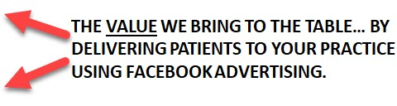
Lifetime Value of a Patient (LTV)
Facebook Advertising for Dentists
Each Patient is worth $4,000 - $8,000... (lifetime value)
5 Patients: $20,000 - $40,000
10 Patients: $40,000 - $80,000
20 Patients: $80,000 - $160,000
30 Patients: $120,000 - $240,000
50 Patients: $200,000 - $400,000
100 Patients: $400,000 - $800,000
With a well crafted offer & campaign managed by us, running on autopilot.
We will deliver patients every month & help to build your practice.
Imagine 30 patients coming in every month, with a Lifetime Value of $120,000 x 12 months
WOW... That works out to over $1,4 million in Patient Sales!
Notes:
Each patient has a Lifetime Value
Lets assume on average, your patients stay with your practice for a period of +/-3 to 5 years.
And on average each patient is worth $4,000 to $8,000 dollars each.
If we bring in 5 patients, that’s $20,000 up to $40,000 in sales
10 patients are worth $40 to 80k
20 patients are worth $80 to $160k
30 patients are worth $120 to $240k
50 patients are worth $200 to $400k
And 100 patients have a Lifetime Value - of $400 up to $800,000 in sales.
This is the VALUE we bring to the table.
With a well crafted offer & campaign managed by us, running on autopilot.
We will deliver patients every month & help build your practice FAST
Even if the Life Time Value of a patient is only worth half this amount…. The money math still makes sense!

Slide 48
Facebook Advertising for Dentists
So here is the exact system we use to do this.
Notes:
So here is the exact system we use to do this. (Next Slide)

Slide 49
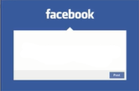
Here’s the strategy on how we do this
Facebook Advertising for Dentists
Facebook Ad, offering foot in the door "Discounted Special Offer"
Thank You
Page
We Have Something Special for You!
Notes:
FIRST, we have a Facebook Advert,
And this FB Ad is offering an “Irresistible Offer”
A foot in the door…Discounted Special Offer, to bring new patients into your practice.
And don’t worry.. I have a swipe file of offers, and will show you examples of OFFERS, that work extremely well for dental practices.
NOW because the offer is SO APPEALING … and non of your competitors are offering this.
A ton of people will sign up for this.
So we target the correct people in your area,
And people see the AD in their FB feed.. and they click on it. (Next Slide)

Slide 50
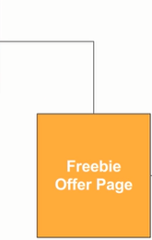
Here’s the strategy on how we do this
Facebook Advertising for Dentists
Facebook Ad, offering foot in the door "Discounted Special Offer"
We Have Something Special for You!
Special Offer
Page
Landing Page, where they enter info to get the special offer.
Notes:
And are then immediately forwarded to a Special Offer Page… this is also know as a Landing Page
And this is where they enter their details in order to get that Special Offer.
We collect their name, email address, and phone number.
So we are driving traffic from Facebook, using Facebook Ads
To the Special Offer page.
So once they fill out their details, and press the Submit button… (Next Slide)

Slide 51
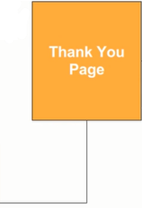
Here’s the strategy on how we do this
Facebook Advertising for Dentists
Facebook Ad, offering foot in the door "Discounted Special Offer"
Thank You Page, where we offer additional BONUS for scheduling appointment NOW.
Thank You
Page
We Have Something Special for You!
Special Offer
Page
Landing Page, where they enter info to get the special offer.
Notes:
They are then taken to the next page, called the Thank You Page.
Now on the Thank You Page, we have a surprise for our customer.
And that surprise is another Un-Announced BONUS
WHERE we offer something of value for FREE… IF they take an IMMEDIATE ACTION
Which is to schedule a proper appointment with your office, in the next 5 minutes.
An example of this could be… FREE X-Rays OR another $10 off on the Special, or something that will WOW your patient.
NOW.. WHY DO WE DO THIS?
We do it is because we want that Second Commitment
We want a proper booked appointment with your office.
Even thou a number of people Will Take Advantage of Your Special Offer
Life gets in the way, people will forget about it.
BUT by offering another BONUS, for people to schedule an appointment.
You will get a much higher percentage of people actually showing up to your office,
because now they have committed to a proper doctors appointment. (Next Slide)

Slide 52

Here’s the strategy on how we do this
Facebook Advertising for Dentists
Facebook Ad, offering foot in the door "Discounted Special Offer"
Thank You Page, where we offer additional BONUS for scheduling appointment NOW.
Thank You
Page
We Have Something Special for You!
Automatic Emails, sending them reminders & reasons why to book appointment.
Special Offer
Page
Landing Page, where they enter info to get the special offer.
Notes:
Next.. we email them over several days.
And these are automatic emails that go out.
Where we send reminders, and reasons why they need to come in.
And again , just like the Thank You page
We are increasing the percentage of people, that will take action, and actually show up… (Next Slide)

Slide 53
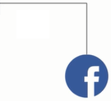
Here’s the strategy on how we do this
Facebook Advertising for Dentists
Facebook Ad, offering foot in the door "Discounted Special Offer"
Thank You Page, where we offer additional BONUS for scheduling appointment NOW.
Thank You
Page
We Have Something Special for You!
Automatic Emails, sending them reminders & reasons why to book appointment.
Special Offer
Page
Landing Page, where they enter info to get the special offer.
"Reminder" Facebook Ads where we remind them about the special offer and to book appointment.
Notes:
Next - We also run “Retargeting Ads”
Now what this is… Is another Facebook Ad
But It’s ONLY shown to people, that actually visited the Special Offer Page
And again, its to remind them about the special offer and convert them to taking action.
And ALL These Things, They work In Conjunction, To Bring New Patients into your practice. (Next Slide)

Slide 54
Predictable Stream of New Patients!
Facebook Advertising for Dentists
Facebook Ad, offering foot in the door "Discounted Special Offer"
Thank You Page, where we offer additional BONUS for scheduling appointment NOW.
Thank You
Page
We Have Something Special for You!
Automatic Emails, sending them reminders & reasons why to book appointment.
Special Offer
Page
Landing Page, where they enter info to get the special offer.
"Reminder" Facebook Ads where we remind them about the special offer and to book appointment.
Notes:
This Is How It’s Done!
And is the EXACT MODEL, used by other successful dental practices, to bring in a “Predictable Stream Of Patients”… (Next Slide)

Slide 55
“The Crazy Discount Funnel”
Facebook Advertising for Dentists
Facebook Ad, offering foot in the door "Discounted Special Offer"
Thank You Page, where we offer additional BONUS for scheduling appointment NOW.
Thank You
Page
We Have Something Special for You!
Automatic Emails, sending them reminders & reasons why to book appointment.
Special Offer
Page
Landing Page, where they enter info to get the special offer.
"Reminder" Facebook Ads where we remind them about the special offer and to book appointment.
Notes:
And this is also known as The Crazy Discount Funnel. (Next Slide)

Slide 56
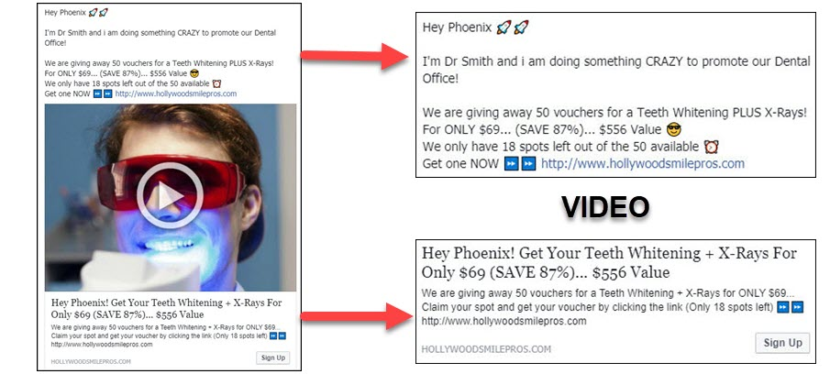
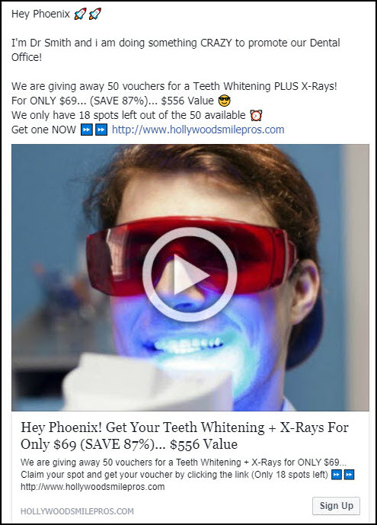
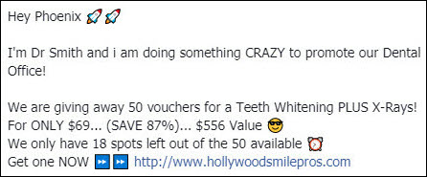
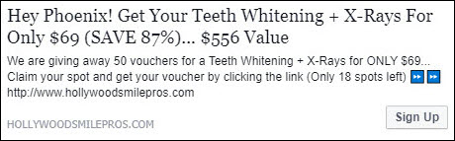
Example of a Facebook Ad
Facebook Advertising for Dentists
Notes:
So Here is an Example of a Facebook Advert for Dentists
This is what it will look like… and lets take a look at the actual offer
And the Offer Reads:
Hey Phoenix... Ime Dr Smith and i doing something CRAZY to promote our Dental Office!
We are giving away 50 vouchers for a Teeth Whitening + X-Rays
For ONLY $69 (SAVE 87%)... $556 Value.
We only have 18 spots left out of 50 available.
Get one NOW by clicking this link...
And then there is a VIDEO.
And beneath the video it reads
Hey Phoenix...Get Your Teeth Whitening + X-Rays for ONLY $69… (SAVE 87%)... $556 Value. … and the copy is repeated.
And on the bottom Right...There is a button they can click on… that says Sign Up. (Next Slide)

Slide 57
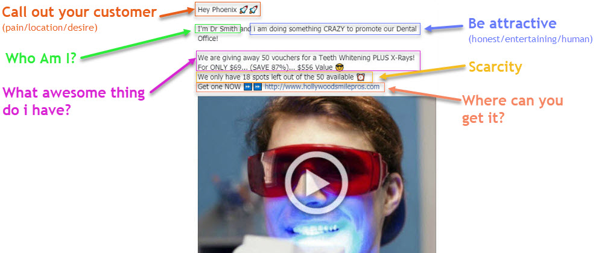
Formula to write Facebook Ad
Facebook Advertising for Dentists
Notes:
SO here is the “FORMULA” we use to write a FB Advert.
We are following a Proven Formula, and cover the following elements
First we do a call-out to our customer.
We then tell them who we are.
We then tell them WHY we are doing it,…. we are being ATTRACTIVE.
We then explain the awesome thing we have to offer.
We include a link and tell them where they can get it.
And we also include Scarcity.. Letting them know they need to take Action NOW… Because we only have a few spots left.
And when you combine all these elements You Create A Winning AD.
SO a person sees this AD in their FB feed & they clicks on it (Next Slide)

Slide 58
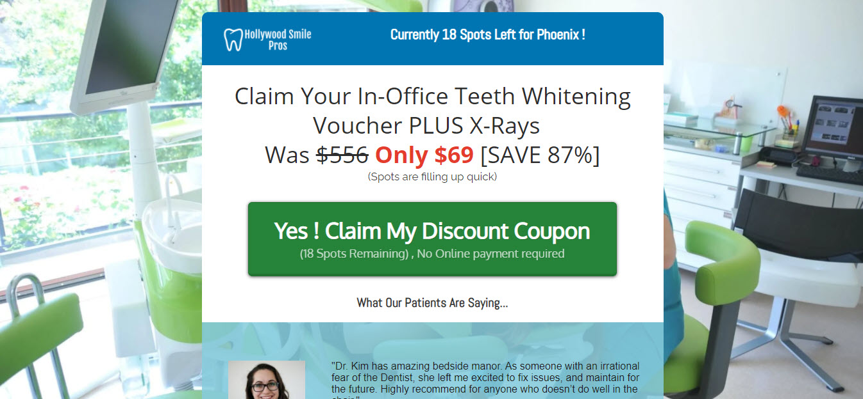
What The “Special Offer Page” Will Look Like
Facebook Advertising for Dentists
Notes:
And it takes them to: The “Special Offer Page’ or Landing Page
This is what the website page looks like.
And we will be using pictures from your dental practice here. We will custom make this page specifically for your practice.
And Here Is Another EXAMPLE... Of Another OFFER
A Teeth Whitening Offer … And The Offer Reads:
Claim Your In-Office Teeth Whitening.. Was $399.. Now ONLY $32… SAVE 91%
Can You See How Exciting These Offers Are?
It is something.. that would stop someone in their tracks and say.. WOW, I want this!
And this, IS THE TYPE OF OFFER THAT WORKS, It makes you stand out from your competitors, and will get a lot of attention.
So they click on the green button that says..
YES, Claim My Discount Coupon (Next Slide)

Slide 59
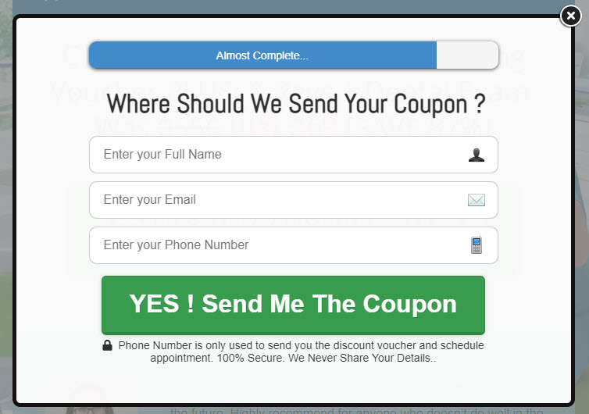
What The “Pop-Up Box” Will Look Like
Facebook Advertising for Dentists
Notes:
And a Box will pop-up
Asking them for their name, email and telephone number.
They fill out their details and press the green button
And they are immediately forward to.. (Next Slide)

Slide 60
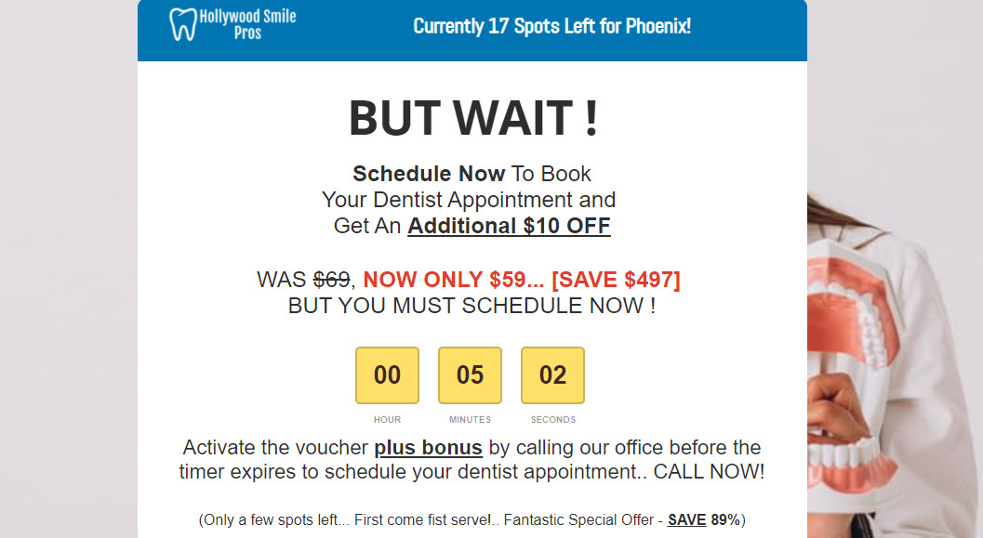
What The “Thank You Page” Will Look Like
Facebook Advertising for Dentists
Notes:
The Thank You Page… and this is what the page looks like.
And again, we will be using pictures from your dental practice and custom make this page for you.
And this is the page where we Surprise Them. And give them an Extra BONUS if they take action now.
And The OFFER Reads:
BUT WAIT - Schedule Now To ACTIVATE Your Voucher
And Get An Additional $10 Off… WAS $32, NOW Only $22
BUT YOU MUST SCHEDULE NOW !
And beneath, there is a countdown timer set to 5 minutes
Which will push them, to pick up the phone and call your office to make that appointment
And Again, as a customer.. That’s Exciting.. And this will convert a high % of people.
CAN YOU SEE, How This Is ALL Coming Together Now (Next Slide)

Slide 61
3 Main Secrets To Making Facebook Ads Work
Facebook Advertising for Dentists
Notes:
NOW… I would like to share,
3 Main Secrets To Making FB ADs Work.
And why this is working so well for others (Next Slide)

Slide 62
SECRET # 1
Facebook Advertising for Dentists
Facebook Ads can be EXTREMELY low cost if you take the time to set up Split Testing properly.
Notes:
The first secret is…
Facebook Ads can be EXTREMELY low cost
If you take the time to set up “Split Testing” properly. (Next Slide)

Slide 63
Split Testing Adverts
Facebook Advertising for Dentists
to bring cost down!
Advert 1
Cost = $30,63 per lead
WINNING AD
RUN WITH THIS AD!
Advert 2
Cost = $16,78 per lead
Advert 3
Cost = $22,84 per lead
Notes:
And by “split testing” I mean taking an offer and creating 3 variations of that offer
and running it through Facebook… testing them side by side.
AND FINDING THE OFFER, that delivers the most amount of leads ,for the cheapest possible price.
We can also test different audiences within your area
And this allows us decrease our Ad Spend, and increase Sales.
So for this example:
Advert 1, brings in leads at $7.63 each.
While Advert 3 is generating leads at $5,84
And Advert 2 is bringing in leads at ONLY $3,78 per lead.
So Advert 2 is our winning ad.
So we stop with Advert 1 & Advert 3.. We cancel them
And we run with Advert 2. (Next Slide)

Slide 64
SECRET # 2
Facebook Advertising for Dentists
People love to be educated, especially with video.
Notes:
So Here Is Secret # 2
Potential BUYERS Love to be Educated… Especially with VIDEO (Next Slide)

Slide 65
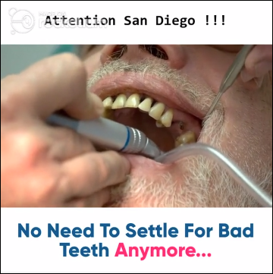
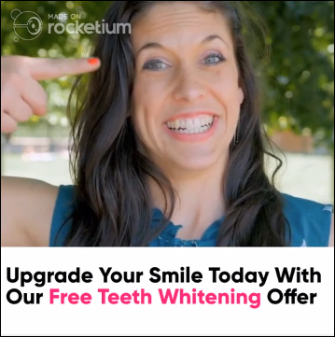
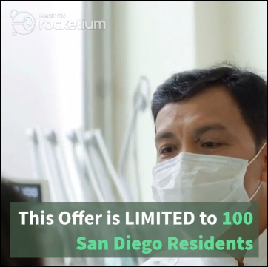
Video For Facebook Advert
Facebook Advertising for Dentists
Educational video explaining special offer
Notes:
So here is an example of what a video would look like,
And these are slides from our video.
And Facebook loves this too,
Facebook loves video, And rewards you for creating video’s in your FB Ads.
So I like to include a video on every Facebook Ad I do..
But we can also use images for this, if we don’t have a video
But video, will help to convert more people into taking you up on your special offer.
And it will also help to reduce the cost on Ad spend. (Next Slide)

Slide 66
SECRET # 3
Facebook Advertising for Dentists
The Money Is In The Follow-Up!
Setting up Email Reminders plus Re-Targeting Facebook Ads
PLUS… Having your office following up with leads!
Notes:
So that brings me to Secret # 3
And that is - The Money Is In The Follow-Up!
Setting up those Email Reminders plus
Re-Targeting Facebook Ads, that go out automatically
AND EVEN MORE IMPORTANT IS, Having Your Office, Follow-Up with Leads… (Next Slide)

Slide 67




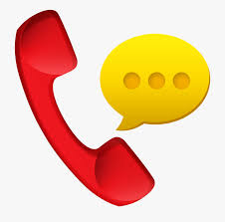
The Money is in the Follow-Up
Facebook Advertising for Dentists
Special Offer Page
Automatic Emails, sending them reminders or reasons why to book appointment.
Thank You Page
Reminder... Facebook Re-Targeting Ads appearing in their Facebook feed.
Secretary… Phoning every lead that comes in, securing an appointment within 5 minutes of receiving lead!
Notes:
Every lead that comes in is money.. Its Your Money.. And in order for you to be successful.
You need to follow up with each patient.
Now this will happen automatically with the Emails and Facebook Re-Targeting Ads that we set up.
But it’s Extremely Important to have someone like your secretary manually follow-up.
To pick up the phone within 5 minutes of receiving a lead, and scheduling an appointment.
Up to this point.. Everything has been done online… BUT nothing is going to work better than having that human connection.
As a client.. Your patients are going to be hugely impressed with you.. If they fill out a form online for a fantastic Special Offer,
and then within minutes, receive a phone call from your secretary,
thanking them for signing up, and scheduling them for an appointment.
You will convert far more people into your practice this way.. Than with the other methods combined
And it will make your campaigns a HUGE SUCCESS. (Next Slide)

Slide 68
Recap on Patient Delivery System
Facebook Advertising for Dentists
Facebook Ad, offering foot in the door "Discounted Special Offer"
Thank You Page, where we offer additional BONUS for scheduling appointment NOW.
Thank You
Page
We Have Something Special for You!
Automatic Emails, sending them reminders & reasons why to book appointment.
Special Offer
Page
Secretary Follow-Up within 5 minutes!
Landing Page, where they enter info to get the special offer.
"Reminder" Facebook Ads where we remind them about the special offer and to book appointment.
Notes:
So to recap.. The whole strategy here is
You run a Facebook Ad offering an Irresistible Special Offer… they click on the Ad and are taken to a
Special Offer Page or Landing Page, where they fill out their information.
They are then taken to a Thank You Page where you offer an additional bonus if they book an appointment with you now in the next 5 minutes.
And then you remind them with emails and retargeting FB Ads, that go out automatically..
PLUS you get your secretary to manually follow up with leads.
And this system here.. Is a complete system that will generate leads on autopilot... AND IT WORKS, IT JUST PLAIN WORKS!
Its working for others and it will work for you, if you implement this
It will BRING IN as many patients as you can handle, and fill your practice to capacity. (Next Slide)

Slide 69
Would you like help doing this?
Facebook Advertising for Dentists
Notes:
So my question now is.. Would you like help doing this?
Would you like help taking this system .. This process of running Facebook Ad’s
And putting it into action for your Dental practice?
If you like what you see here… AND would like my help… (Next Slide)

Slide 70
Here is my offer to you…
Facebook Advertising for Dentists
Notes:
Here is my offer to you… (Next Slide)

Slide 71
I’m looking to work with 7 dental practices over the next 90 days to implement a “patient delivery system” and automate your patient acquisition.
Facebook Advertising for Dentists
Notes:
I’m looking to work with 7 dental practices over the next 90 days
to implement a “Patient Delivery System”
and automate your patient acquisition… (Next Slide)

Slide 72
We’re going with 7 because that’s how many campaigns my team can handle and focus on at one time.
Facebook Advertising for Dentists
Notes:
We’re going with 7 because that’s about how many clients I can and focus on at one time, without going certifiable insane.… (Next Slide)

Slide 73
So here’s what your going to get…
Facebook Advertising for Dentists
Notes:
So here’s what your going to get…… (Next Slide)

Slide 74
Work Involved In Running a Successful Campaign
Facebook Advertising for Dentists
Creating The Facebook Adverts.
Notes:
This Is The Work Involved In Running a Successful Campaign
Number One is- Creating The Facebook Adverts (Next Slide)

Slide 75
Work Involved In Running a Successful Campaign
Facebook Advertising for Dentists
Creating The Facebook Adverts.
Marketing Video.
Notes:
Number Two is - Creating Your Marketing Video. (Next Slide)

Slide 76
Work Involved In Running a Successful Campaign
Facebook Advertising for Dentists
Creating The Facebook Adverts.
Marketing Video.
Building out the Funnel Pages.
Notes:
Number Three is - Building out and hosting the Funnel Pages. (Next Slide)

Slide 77
Work Involved In Running a Successful Campaign
Facebook Advertising for Dentists
Creating The Facebook Adverts.
Marketing Video.
Building out the Funnel Pages.
Setting up Email Reminders.
Notes:
Number Four is - Setting up Email Reminders. (Next Slide)

Slide 78
Work Involved In Running a Successful Campaign
Facebook Advertising for Dentists
Creating The Facebook Adverts.
Marketing Video.
Building out the Funnel Pages.
Setting up Email Reminders.
Creating the Re-targeting Facebook Ads.
Notes:
Number Five is - Creating the Re-targeting Facebook Ads. (Next Slide)

Slide 79
Work Involved In Running a Successful Campaign
Facebook Advertising for Dentists
Creating The Facebook Adverts.
Marketing Video.
Building out the Funnel Pages.
Setting up Email Reminders.
Creating the Re-targeting Facebook Ads.
Audience Research & targeting the correct audience.
Notes:
Number Six is - Audience Research & targeting the correct audiences… (Next Slide)

Slide 80
Work Involved In Running a Successful Campaign
Facebook Advertising for Dentists
Creating The Facebook Adverts.
Marketing Video.
Building out the Funnel Pages.
Setting up Email Reminders.
Creating the Re-targeting Facebook Ads.
Audience Research & targeting the correct audience
Split Testing different Ad-Variations.
Notes:
Number Seven is - Split Testing different Ad-Variations. (Next Slide)

Slide 81
Work Involved In Running a Successful Campaign
Facebook Advertising for Dentists
Creating The Facebook Adverts.
Marketing Video.
Building out the Funnel Pages.
Setting up Email Reminders.
Creating the Re-targeting Facebook Ads.
Audience Research & targeting the correct audience
Split Testing different Ad-Variations.
Finding the winning Offers and running with them.
Notes:
And Lastly Number Eight is - Finding the Winning Offers and running with them… (Next Slide)

Slide 82
To bring in patients at the lowest possible price… At under $20 per patient.
Facebook Advertising for Dentists
My Goal
And to get you such a high ROI that you will see me as an integral part of your team and you will be wanting to take out an insurance policy on my services ☺… and it will more than justify my fee.
Notes:
MY GOAL... Is to bring in patients at the lowest possible price… At Under $5 per lead.
AND to get you such a High Return On Investment,
That you will see me as an integral part of your team
And you will be wanting to take out an insurance policy on my services
And it will more than justify my fee… (Next Slide)

Slide 83
Facebook Advertising for Dentists
I am ONLY offering this service to 7 dental practices!
And I will only work with one dental practice per area, once those 7 spots are filled I will be shutting this offer down.
This offer has gone out to other dental practices in your area!
Notes:
NOW PLEASE NOTE... I am ONLY offering this service to 7 dental practices
And I will only work with one dentist per area.
Once those 7 spots are filled... I WILL BE shutting this offer down… So I can focus getting results for dental practices that take me up on this offer.
And this offer has gone out to other dentists in your area... (Next Slide)

Slide 84
Facebook Advertising for Dentists
MY RISK-FREE GUARANTEE TO YOU
I am so confident in this system, that if you implement this.
And don’t see back at least your initial investment in month one.
I’ll refund you the difference out of my own pocket!
For Example:
If you spend $2,500 on advertising with us… And we only bring in $2,000 in patient sales… I will refund you the difference of $500... So at a bare minimum… You are guaranteed to make your money back!
I TAKE AWAY ALL THE RISK
And make sure your campaigns are successful from day one!
Notes:
NOW… HERE IS MY RISK FREE GUARANTEE TO YOU
I am so confident in this system, that if you implement this.
And don’t see back at least your initial investment … in month one.
I’ll Refund You The Difference, Out Of My Own Pocket!
For Example... If you spend $2,000 on advertising…
And we Only bring in $1,500 in sales… I WILL REFUND YOU THE DIFFERENCE of $500
So you are guaranteed at a bare minimum to make your money back.
I Take Away All The Risk and make sure your campaigns are successful.

Slide 85
Facebook Advertising for Dentists
If this sounds good and you like what you see here and you want to take advantage of this “Done-For-You” service.
Notes:
SO, If that sounds good
and you like what you see here
and you want to take advantage of this “Done-For-You” service.… (Next Slide)

Slide 86
Facebook Advertising for Dentists
You can book a free strategy call with me, its absolutely free and we can discuss how to implement this into your dental practice for you personally.
Notes:
You can book a free strategy call with me, its absolutely free.
And we can discuss how to implement this into your Dental Practice for you personally.… (Next Slide)

Slide 87
Facebook Advertising for Dentists
All you have to do is click the blue button below this video to book-a-call with me… choose a date & time
Notes:
All you have to do is click the link below this video to book-a-call with me.
And you’ll then be sent to a questionnaire to tell me a bit about your dental practice .
And if it all checks out… I will get on a call with you… (Next Slide)

Slide 88
Facebook Advertising for Dentists
So now, you have 2 options…
Notes:
So now, you have 2 options… (Next Slide)

Slide 89
1.) Go at it alone and try the “Do-It-Yourself” route.
Facebook Advertising for Dentists
Notes:
Number 1… Go at it alone… and try the “Do-It-Yourself” route.

Slide 90
Facebook Advertising for Dentists
And Then You Need To Become An Expert On:
The “Facebook Business Manager” and setting it up properly.
Purchasing website software & hosting… and learning how to set up funnels.
Sales Copy… and figuring out what Offers work best.
Purchasing Email Software… and learning how to set it up.
Email Copywriting… and creating your “follow-up emails”.
Audience Research… and knowing how to split-test different audiences.
Creating Look-a-Like audience of your ideal patients & launching Re-targeting ads.
Creating multiple versions of your Ads and split-testing to reduce cost.
Know how to run multiple campaigns at once… To find the winning offers & scale up.
Know when to switch-off campaigns… and use data to deploy new campaigns.
Setting up all the tech, and making sure things are running properly.
Make sure you’re not wasting you advertising dollars on silly mistakes.
All the while running your own practice, managing staff & working on patients
Notes:
And Then Need To Become An Expert
On the “Facebook Business Manager” and setting it up properly.
Purchasing website software & hosting… and learn how to set up funnels.
Sales Copy… and figuring out what Offers work best.
Creating Marketing Videos.
Purchasing Email Software… and learning how to set it up.
Email Copywriting… and creating “follow-up emails”.
Audience Research… and how to split test.
Look-a-Like Audience… how to set them up.
Adverts... how to create them and how to split-test Ads.
How to run multiple campaigns… To find the winning offers.
Know when to switch-off campaigns… and use the data to deploy new campaigns.
All the while…. making sure you’re not wasting you advertising dollars on mistakes.
And the list of tasks goes on…

Slide 91
Facebook Advertising for Dentists
And Then You Need To Become An Expert On:
The “Facebook Business Manager” and setting it up properly.
Purchasing website software & hosting… and learning how to set up funnels.
Sales Copy… and figuring out what Offers work best.
Purchasing Email Software… and learning how to set it up.
Email Copywriting… and creating your “follow-up emails”.
Audience Research… and knowing how to split-test different audiences.
Creating Look-a-Like audience of your ideal patients & launching Re-targeting ads.
Creating multiple versions of your Ads and split-testing to reduce cost.
Know how to run multiple campaigns at once… To find the winning offers & scale up.
Know when to switch-off campaigns… and use data to deploy new campaigns.
Setting up all the tech, and making sure things are running properly.
Make sure you’re not wasting you advertising dollars on silly mistakes.
All the while running your own practice, managing staff & working on patients
Notes:
And Then Need To Become An Expert
On the “Facebook Business Manager” and setting it up properly.
Purchasing website software & hosting… and learn how to set up funnels.
Sales Copy… and figuring out what Offers work best.
Creating Marketing Videos.
Purchasing Email Software… and learning how to set it up.
Email Copywriting… and creating “follow-up emails”.
Audience Research… and how to split test.
Look-a-Like Audience… how to set them up.
Adverts... how to create them and how to split-test Ads.
How to run multiple campaigns… To find the winning offers.
Know when to switch-off campaigns… and use the data to deploy new campaigns.
All the while…. making sure you’re not wasting you advertising dollars on mistakes.
And the list of tasks goes on…

Slide 92
Facebook Advertising for Dentists
And Then You Need To Become An Expert On:
The “Facebook Business Manager” and setting it up properly.
Purchasing website software & hosting… and learning how to set up funnels.
Sales Copy… and figuring out what Offers work best.
Purchasing Email Software… and learning how to set it up.
Email Copywriting… and creating your “follow-up emails”.
Audience Research… and knowing how to split-test different audiences.
Creating Look-a-Like audience of your ideal patients & launching Re-targeting ads.
Creating multiple versions of your Ads and split-testing to reduce cost.
Know how to run multiple campaigns at once… To find the winning offers & scale up.
Know when to switch-off campaigns… and use data to deploy new campaigns.
Setting up all the tech, and making sure things are running properly.
Make sure you’re not wasting you advertising dollars on silly mistakes.
All the while running your own practice, managing staff & working on patients
Notes:
And Then Need To Become An Expert
On the “Facebook Business Manager” and setting it up properly.
Purchasing website software & hosting… and learn how to set up funnels.
Sales Copy… and figuring out what Offers work best.
Creating Marketing Videos.
Purchasing Email Software… and learning how to set it up.
Email Copywriting… and creating “follow-up emails”.
Audience Research… and how to split test.
Look-a-Like Audience… how to set them up.
Adverts... how to create them and how to split-test Ads.
How to run multiple campaigns… To find the winning offers.
Know when to switch-off campaigns… and use the data to deploy new campaigns.
All the while…. making sure you’re not wasting you advertising dollars on mistakes.
And the list of tasks goes on…

Slide 93
Facebook Advertising for Dentists
And Then You Need To Become An Expert On:
The “Facebook Business Manager” and setting it up properly.
Purchasing website software & hosting… and learning how to set up funnels.
Sales Copy… and figuring out what Offers work best.
Purchasing Email Software… and learning how to set it up.
Email Copywriting… and creating your “follow-up emails”.
Audience Research… and knowing how to split-test different audiences.
Creating Look-a-Like audience of your ideal patients & launching Re-targeting ads.
Creating multiple versions of your Ads and split-testing to reduce cost.
Know how to run multiple campaigns at once… To find the winning offers & scale up.
Know when to switch-off campaigns… and use data to deploy new campaigns.
Setting up all the tech, and making sure things are running properly.
Make sure you’re not wasting you advertising dollars on silly mistakes.
All the while running your own practice, managing staff & working on patients
Notes:
And Then Need To Become An Expert
On the “Facebook Business Manager” and setting it up properly.
Purchasing website software & hosting… and learn how to set up funnels.
Sales Copy… and figuring out what Offers work best.
Creating Marketing Videos.
Purchasing Email Software… and learning how to set it up.
Email Copywriting… and creating “follow-up emails”.
Audience Research… and how to split test.
Look-a-Like Audience… how to set them up.
Adverts... how to create them and how to split-test Ads.
How to run multiple campaigns… To find the winning offers.
Know when to switch-off campaigns… and use the data to deploy new campaigns.
All the while…. making sure you’re not wasting you advertising dollars on mistakes.
And the list of tasks goes on…

Slide 94
Facebook Advertising for Dentists
And Then You Need To Become An Expert On:
The “Facebook Business Manager” and setting it up properly.
Purchasing website software & hosting… and learning how to set up funnels.
Sales Copy… and figuring out what Offers work best.
Purchasing Email Software… and learning how to set it up.
Email Copywriting… and creating your “follow-up emails”.
Audience Research… and knowing how to split-test different audiences.
Creating Look-a-Like audience of your ideal patients & launching Re-targeting ads.
Creating multiple versions of your Ads and split-testing to reduce cost.
Know how to run multiple campaigns at once… To find the winning offers & scale up.
Know when to switch-off campaigns… and use data to deploy new campaigns.
Setting up all the tech, and making sure things are running properly.
Make sure you’re not wasting you advertising dollars on silly mistakes.
All the while running your own practice, managing staff & working on patients
Notes:
And Then Need To Become An Expert
On the “Facebook Business Manager” and setting it up properly.
Purchasing website software & hosting… and learn how to set up funnels.
Sales Copy… and figuring out what Offers work best.
Creating Marketing Videos.
Purchasing Email Software… and learning how to set it up.
Email Copywriting… and creating “follow-up emails”.
Audience Research… and how to split test.
Look-a-Like Audience… how to set them up.
Adverts... how to create them and how to split-test Ads.
How to run multiple campaigns… To find the winning offers.
Know when to switch-off campaigns… and use the data to deploy new campaigns.
All the while…. making sure you’re not wasting you advertising dollars on mistakes.
And the list of tasks goes on…

Slide 95
Facebook Advertising for Dentists
And Then You Need To Become An Expert On:
The “Facebook Business Manager” and setting it up properly.
Purchasing website software & hosting… and learning how to set up funnels.
Sales Copy… and figuring out what Offers work best.
Purchasing Email Software… and learning how to set it up.
Email Copywriting… and creating your “follow-up emails”.
Audience Research… and knowing how to split-test different audiences.
Creating Look-a-Like audience of your ideal patients & launching Re-targeting ads.
Creating multiple versions of your Ads and split-testing to reduce cost.
Know how to run multiple campaigns at once… To find the winning offers & scale up.
Know when to switch-off campaigns… and use data to deploy new campaigns.
Setting up all the tech, and making sure things are running properly.
Make sure you’re not wasting you advertising dollars on silly mistakes.
All the while running your own practice, managing staff & working on patients
Notes:
And Then Need To Become An Expert
On the “Facebook Business Manager” and setting it up properly.
Purchasing website software & hosting… and learn how to set up funnels.
Sales Copy… and figuring out what Offers work best.
Creating Marketing Videos.
Purchasing Email Software… and learning how to set it up.
Email Copywriting… and creating “follow-up emails”.
Audience Research… and how to split test.
Look-a-Like Audience… how to set them up.
Adverts... how to create them and how to split-test Ads.
How to run multiple campaigns… To find the winning offers.
Know when to switch-off campaigns… and use the data to deploy new campaigns.
All the while…. making sure you’re not wasting you advertising dollars on mistakes.
And the list of tasks goes on…

Slide 96
Facebook Advertising for Dentists
And Then You Need To Become An Expert On:
The “Facebook Business Manager” and setting it up properly.
Purchasing website software & hosting… and learning how to set up funnels.
Sales Copy… and figuring out what Offers work best.
Purchasing Email Software… and learning how to set it up.
Email Copywriting… and creating your “follow-up emails”.
Audience Research… and knowing how to split-test different audiences.
Creating Look-a-Like audience of your ideal patients & launching Re-targeting ads.
Creating multiple versions of your Ads and split-testing to reduce cost.
Know how to run multiple campaigns at once… To find the winning offers & scale up.
Know when to switch-off campaigns… and use data to deploy new campaigns.
Setting up all the tech, and making sure things are running properly.
Make sure you’re not wasting you advertising dollars on silly mistakes.
All the while running your own practice, managing staff & working on patients
Notes:
And Then Need To Become An Expert
On the “Facebook Business Manager” and setting it up properly.
Purchasing website software & hosting… and learn how to set up funnels.
Sales Copy… and figuring out what Offers work best.
Creating Marketing Videos.
Purchasing Email Software… and learning how to set it up.
Email Copywriting… and creating “follow-up emails”.
Audience Research… and how to split test.
Look-a-Like Audience… how to set them up.
Adverts... how to create them and how to split-test Ads.
How to run multiple campaigns… To find the winning offers.
Know when to switch-off campaigns… and use the data to deploy new campaigns.
All the while…. making sure you’re not wasting you advertising dollars on mistakes.
And the list of tasks goes on…

Slide 97
Facebook Advertising for Dentists
And Then You Need To Become An Expert On:
The “Facebook Business Manager” and setting it up properly.
Purchasing website software & hosting… and learning how to set up funnels.
Sales Copy… and figuring out what Offers work best.
Purchasing Email Software… and learning how to set it up.
Email Copywriting… and creating your “follow-up emails”.
Audience Research… and knowing how to split-test different audiences.
Creating Look-a-Like audience of your ideal patients & launching Re-targeting ads.
Creating multiple versions of your Ads and split-testing to reduce cost.
Know how to run multiple campaigns at once… To find the winning offers & scale up.
Know when to switch-off campaigns… and use data to deploy new campaigns.
Setting up all the tech, and making sure things are running properly.
Make sure you’re not wasting you advertising dollars on silly mistakes.
All the while running your own practice, managing staff & working on patients
Notes:
And Then Need To Become An Expert
On the “Facebook Business Manager” and setting it up properly.
Purchasing website software & hosting… and learn how to set up funnels.
Sales Copy… and figuring out what Offers work best.
Creating Marketing Videos.
Purchasing Email Software… and learning how to set it up.
Email Copywriting… and creating “follow-up emails”.
Audience Research… and how to split test.
Look-a-Like Audience… how to set them up.
Adverts... how to create them and how to split-test Ads.
How to run multiple campaigns… To find the winning offers.
Know when to switch-off campaigns… and use the data to deploy new campaigns.
All the while…. making sure you’re not wasting you advertising dollars on mistakes.
And the list of tasks goes on…

Slide 98
Facebook Advertising for Dentists
And Then You Need To Become An Expert On:
The “Facebook Business Manager” and setting it up properly.
Purchasing website software & hosting… and learning how to set up funnels.
Sales Copy… and figuring out what Offers work best.
Purchasing Email Software… and learning how to set it up.
Email Copywriting… and creating your “follow-up emails”.
Audience Research… and knowing how to split-test different audiences.
Creating Look-a-Like audience of your ideal patients & launching Re-targeting ads.
Creating multiple versions of your Ads and split-testing to reduce cost.
Know how to run multiple campaigns at once… To find the winning offers & scale up.
Know when to switch-off campaigns… and use data to deploy new campaigns.
Setting up all the tech, and making sure things are running properly.
Make sure you’re not wasting you advertising dollars on silly mistakes.
All the while running your own practice, managing staff & working on patients
Notes:
And Then Need To Become An Expert
On the “Facebook Business Manager” and setting it up properly.
Purchasing website software & hosting… and learn how to set up funnels.
Sales Copy… and figuring out what Offers work best.
Creating Marketing Videos.
Purchasing Email Software… and learning how to set it up.
Email Copywriting… and creating “follow-up emails”.
Audience Research… and how to split test.
Look-a-Like Audience… how to set them up.
Adverts... how to create them and how to split-test Ads.
How to run multiple campaigns… To find the winning offers.
Know when to switch-off campaigns… and use the data to deploy new campaigns.
All the while…. making sure you’re not wasting you advertising dollars on mistakes.
And the list of tasks goes on…

Slide 99
Facebook Advertising for Dentists
And Then You Need To Become An Expert On:
The “Facebook Business Manager” and setting it up properly.
Purchasing website software & hosting… and learning how to set up funnels.
Sales Copy… and figuring out what Offers work best.
Purchasing Email Software… and learning how to set it up.
Email Copywriting… and creating your “follow-up emails”.
Audience Research… and knowing how to split-test different audiences.
Creating Look-a-Like audience of your ideal patients & launching Re-targeting ads.
Creating multiple versions of your Ads and split-testing to reduce cost.
Know how to run multiple campaigns at once… To find the winning offers & scale up.
Know when to switch-off campaigns… and use data to deploy new campaigns.
Setting up all the tech, and making sure things are running properly.
Make sure you’re not wasting you advertising dollars on silly mistakes.
All the while running your own practice, managing staff & working on patients
Notes:
And Then Need To Become An Expert
On the “Facebook Business Manager” and setting it up properly.
Purchasing website software & hosting… and learn how to set up funnels.
Sales Copy… and figuring out what Offers work best.
Creating Marketing Videos.
Purchasing Email Software… and learning how to set it up.
Email Copywriting… and creating “follow-up emails”.
Audience Research… and how to split test.
Look-a-Like Audience… how to set them up.
Adverts... how to create them and how to split-test Ads.
How to run multiple campaigns… To find the winning offers.
Know when to switch-off campaigns… and use the data to deploy new campaigns.
All the while…. making sure you’re not wasting you advertising dollars on mistakes.
And the list of tasks goes on…

Slide 100
Facebook Advertising for Dentists
And Then You Need To Become An Expert On:
The “Facebook Business Manager” and setting it up properly.
Purchasing website software & hosting… and learning how to set up funnels.
Sales Copy… and figuring out what Offers work best.
Purchasing Email Software… and learning how to set it up.
Email Copywriting… and creating your “follow-up emails”.
Audience Research… and knowing how to split-test different audiences.
Creating Look-a-Like audience of your ideal patients & launching Re-targeting ads.
Creating multiple versions of your Ads and split-testing to reduce cost.
Know how to run multiple campaigns at once… To find the winning offers & scale up.
Know when to switch-off campaigns… and use data to deploy new campaigns.
Setting up all the tech, and making sure things are running properly.
Make sure you’re not wasting you advertising dollars on silly mistakes.
All the while running your own practice, managing staff & working on patients
Notes:
And Then Need To Become An Expert
On the “Facebook Business Manager” and setting it up properly.
Purchasing website software & hosting… and learn how to set up funnels.
Sales Copy… and figuring out what Offers work best.
Creating Marketing Videos.
Purchasing Email Software… and learning how to set it up.
Email Copywriting… and creating “follow-up emails”.
Audience Research… and how to split test.
Look-a-Like Audience… how to set them up.
Adverts... how to create them and how to split-test Ads.
How to run multiple campaigns… To find the winning offers.
Know when to switch-off campaigns… and use the data to deploy new campaigns.
All the while…. making sure you’re not wasting you advertising dollars on mistakes.
And the list of tasks goes on…

Slide 101
Facebook Advertising for Dentists
And Then You Need To Become An Expert On:
The “Facebook Business Manager” and setting it up properly.
Purchasing website software & hosting… and learning how to set up funnels.
Sales Copy… and figuring out what Offers work best.
Purchasing Email Software… and learning how to set it up.
Email Copywriting… and creating your “follow-up emails”.
Audience Research… and knowing how to split-test different audiences.
Creating Look-a-Like audience of your ideal patients & launching Re-targeting ads.
Creating multiple versions of your Ads and split-testing to reduce cost.
Know how to run multiple campaigns at once… To find the winning offers & scale up.
Know when to switch-off campaigns… and use data to deploy new campaigns.
Setting up all the tech, and making sure things are running properly.
Make sure you’re not wasting you advertising dollars on silly mistakes.
All the while running your own practice, managing staff & working on patients
Notes:
And Then Need To Become An Expert
On the “Facebook Business Manager” and setting it up properly.
Purchasing website software & hosting… and learn how to set up funnels.
Sales Copy… and figuring out what Offers work best.
Creating Marketing Videos.
Purchasing Email Software… and learning how to set it up.
Email Copywriting… and creating “follow-up emails”.
Audience Research… and how to split test.
Look-a-Like Audience… how to set them up.
Adverts... how to create them and how to split-test Ads.
How to run multiple campaigns… To find the winning offers.
Know when to switch-off campaigns… and use the data to deploy new campaigns.
All the while…. making sure you’re not wasting you advertising dollars on mistakes.
And the list of tasks goes on…

Slide 102
Facebook Advertising for Dentists
And Then You Need To Become An Expert On:
The “Facebook Business Manager” and setting it up properly.
Purchasing website software & hosting… and learning how to set up funnels.
Sales Copy… and figuring out what Offers work best.
Purchasing Email Software… and learning how to set it up.
Email Copywriting… and creating your “follow-up emails”.
Audience Research… and knowing how to split-test different audiences.
Creating Look-a-Like audience of your ideal patients & launching Re-targeting ads.
Creating multiple versions of your Ads and split-testing to reduce cost.
Know how to run multiple campaigns at once… To find the winning offers & scale up.
Know when to switch-off campaigns… and use data to deploy new campaigns.
Setting up all the tech, and making sure things are running properly.
Make sure you’re not wasting you advertising dollars on silly mistakes.
All the while running your own practice, managing staff & working on patients
Notes:
And Then Need To Become An Expert
On the “Facebook Business Manager” and setting it up properly.
Purchasing website software & hosting… and learn how to set up funnels.
Sales Copy… and figuring out what Offers work best.
Creating Marketing Videos.
Purchasing Email Software… and learning how to set it up.
Email Copywriting… and creating “follow-up emails”.
Audience Research… and how to split test.
Look-a-Like Audience… how to set them up.
Adverts... how to create them and how to split-test Ads.
How to run multiple campaigns… To find the winning offers.
Know when to switch-off campaigns… and use the data to deploy new campaigns.
All the while…. making sure you’re not wasting you advertising dollars on mistakes.
And the list of tasks goes on…

Slide 103
Facebook Advertising for Dentists
And Then You Need To Become An Expert On:
The “Facebook Business Manager” and setting it up properly.
Purchasing website software & hosting… and learning how to set up funnels.
Sales Copy… and figuring out what Offers work best.
Purchasing Email Software… and learning how to set it up.
Email Copywriting… and creating your “follow-up emails”.
Audience Research… and knowing how to split-test different audiences.
Creating Look-a-Like audience of your ideal patients & launching Re-targeting ads.
Creating multiple versions of your Ads and split-testing to reduce cost.
Know how to run multiple campaigns at once… To find the winning offers & scale up.
Know when to switch-off campaigns… and use data to deploy new campaigns.
Setting up all the tech, and making sure things are running properly.
Make sure you’re not wasting you advertising dollars on silly mistakes.
All the while running your own practice, managing staff & working on patients
Notes:
And Then Need To Become An Expert
On the “Facebook Business Manager” and setting it up properly.
Purchasing website software & hosting… and learn how to set up funnels.
Sales Copy… and figuring out what Offers work best.
Creating Marketing Videos.
Purchasing Email Software… and learning how to set it up.
Email Copywriting… and creating “follow-up emails”.
Audience Research… and how to split test.
Look-a-Like Audience… how to set them up.
Adverts... how to create them and how to split-test Ads.
How to run multiple campaigns… To find the winning offers.
Know when to switch-off campaigns… and use the data to deploy new campaigns.
All the while…. making sure you’re not wasting you advertising dollars on mistakes.
And the list of tasks goes on…

Slide 104
Option Number 1 – Is taking the time to learn all those skills and go the Do-It-Yourself route.
Facebook Advertising for Dentists
Notes:
So Option Number 1 – Is taking time to learn all those skills and go the Do-It-Yourself route.

Slide 105
Facebook Advertising for Dentists
OR
Notes:
OR

Slide 106
“Save Time”... & go for the “Done-For-You” service!
Facebook Advertising for Dentists
Option Number 2
Where we take care of everything for you and focus on one thing only… Which is getting you RESULTS!
By delivering new patients into your practice and filling your practice to capacity.
Notes:
Option Number 2 - Save Time & Go for the "Done-For-You" service.
Where we take care of everything for you.
And focus on one thing only which is getting you RESULTS.
By delivering patients to your practice at under $5 each. .
And filling your practice to capacity with new patients… (Next Slide)

Slide 107
So here’s what to do next…
Facebook Advertising for Dentists
Notes:
So Here’s What To Do Next
Click on the blue button… below this video that says,
YES – I Want To Book a Call & Apply… (Next Slide)

Slide 108

Facebook Advertising for Dentists
Click the blue button below this video
Notes:
So Here’s What To Do Next
Click on the blue button… below this video that says,
YES – I Want To Book a Call & Apply… (Next Slide)

Slide 109
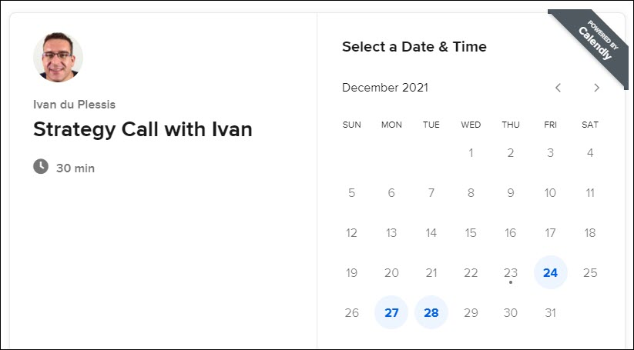
Then choose a date & time to Book a Call
Facebook Advertising for Dentists
Notes:
You will be directed to my Calendar Page where you can “Schedule A Call” with me.
Simply choose a date and time for us to talk… To make sure we are a good fit.
And for you to answer a few of my questions… And also to answer any of your questions.
We will then discuss the “Services You Provide”… and the type of OFFER we both think will best work for your dental practice. . (Next Slide)

Slide 110
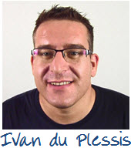
Thank you for watching this training video!
Facebook Advertising for Dentists
Notes:
So thank you so much for watching this training video
I hope it helps.. and you got some value out of this video…
And you are able to put this strategy into practice for your business.
And If You Need Help With This and Looking for a “Done For You” service
Once Again, you can CLICK on the button below this video.
BOOK A CALL with me, answer a few question
And I will go over this system with you personally on the phone.
And discuss how to implement this into your Dental Practice.
So Thank You So Much... And I Hope To Hear From You Soon. (The End)

Slide 111
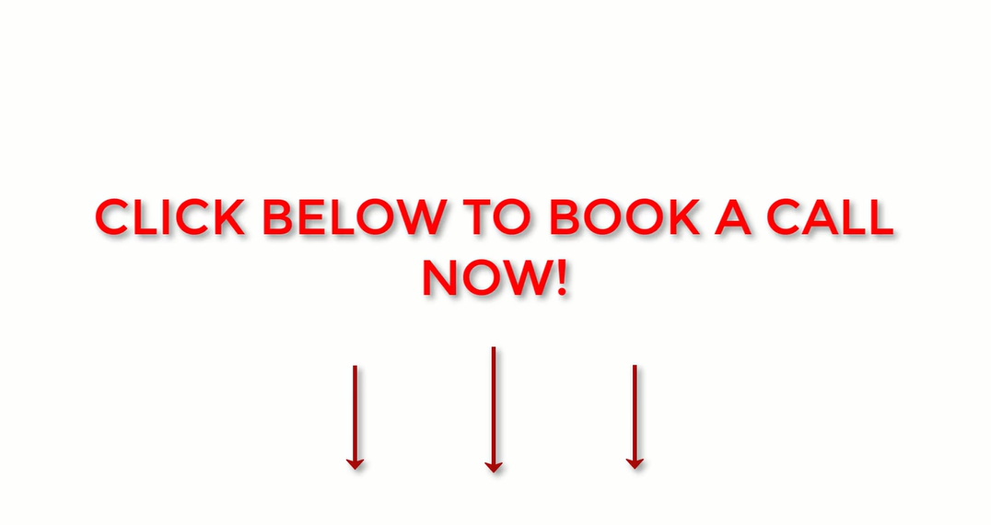

Slide 112
